Slide 1
Neural Networks Assignment 1
Lucas Ortiz Duhart - lo21410

Slide 2
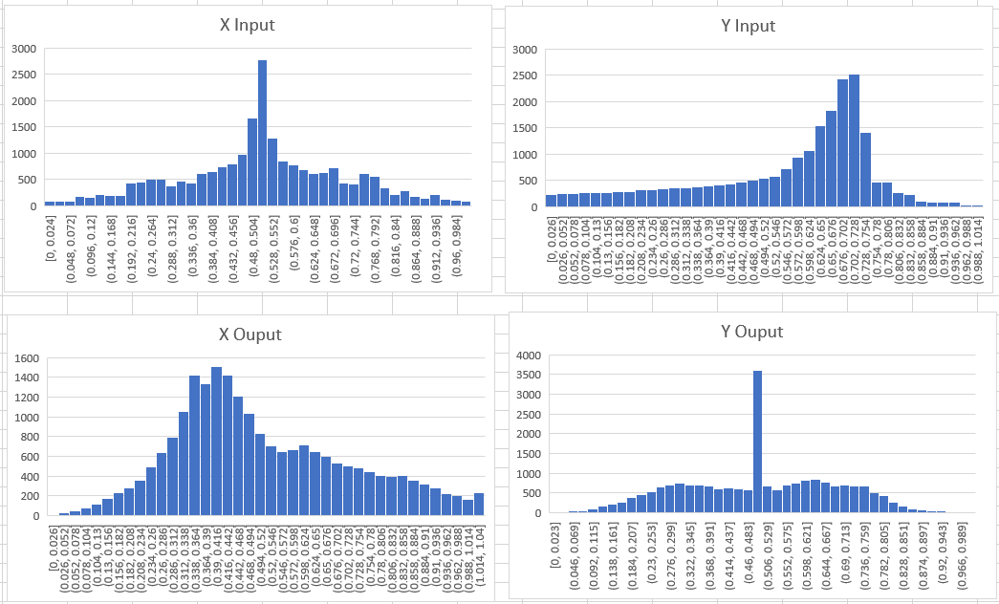
Data
The data collected consisted of 15000 lines of training data and 3000 lines of testing data.
Data was slightly skewed, which may have resulted in the way the game behaved
To process data, any conflicting values (same input, different outcome) were removed, keeping the ones that made more sense

Slide 3
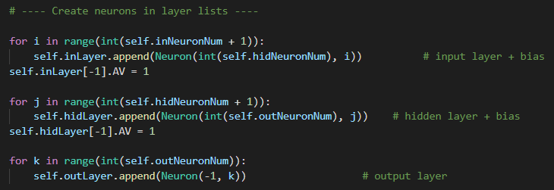
Design choices
The whole network is completely scalable for input, hidden and output neurons
Bias neuron for input and hidden were added at the end of each layer

Slide 4
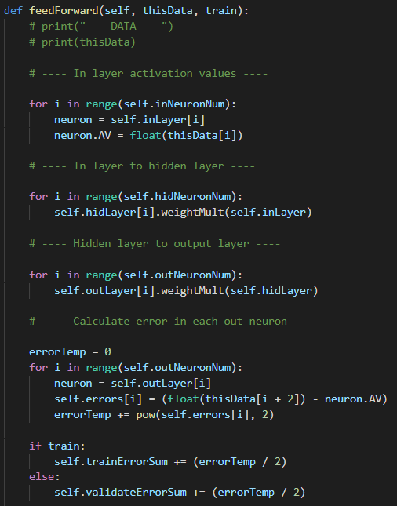
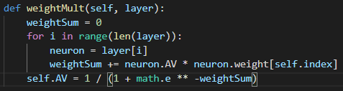
Feed Forward
Input/hidden neurons store weights
Weight multiply function receives left layer and uses weights stored there to calculate activation values

Slide 5
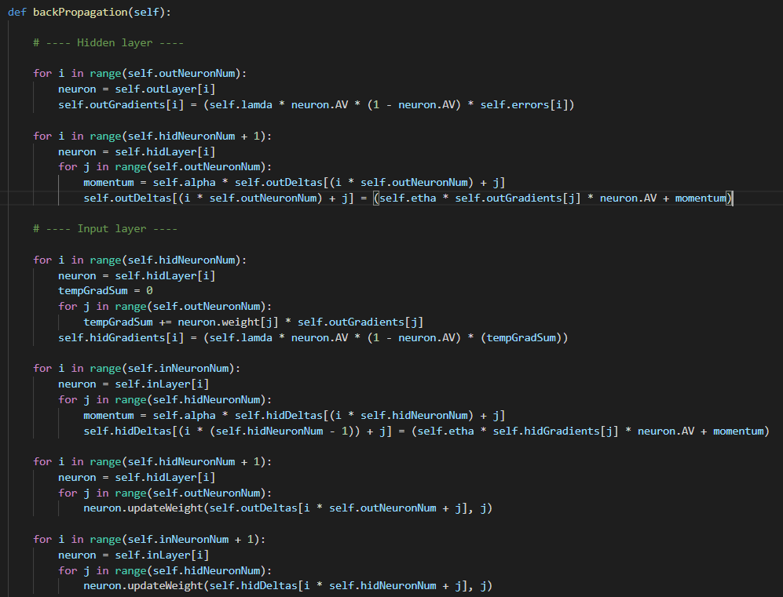
Back Propagation
Gradients and deltas were saved in a list, which was initialized as empty of the proper size
These parameters are overwritten every iteration
Goes from output to hidden calculating first gradients and then deltas, and finally adds these to the neurons with updateweight function

Slide 6
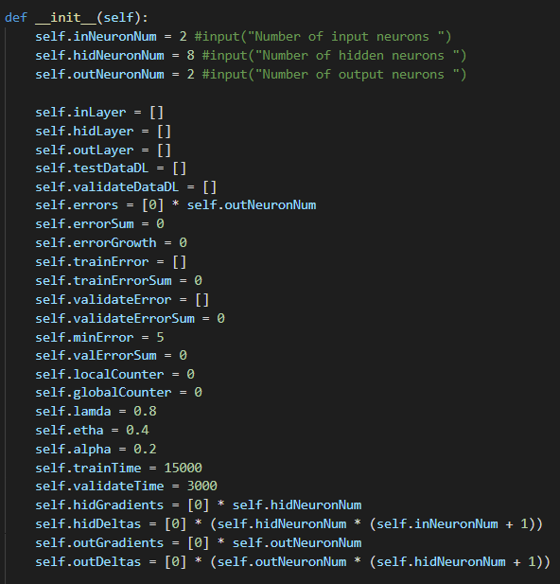
Parameter Selection
Trial and error for selection of best parameters
Different iterations were run changing parameters between each one until an optimal selection was reached
8 hidden neurons produced the best result
Low alpha means changes between epoch are slow, but a lower error is reached

Slide 7
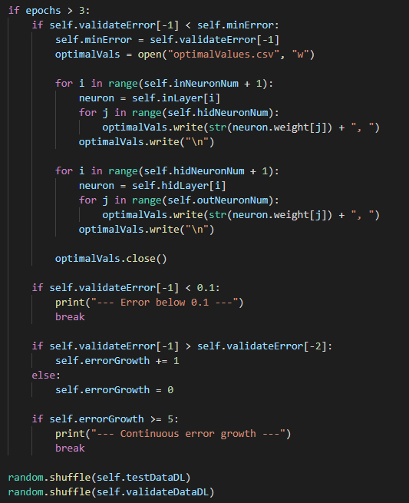
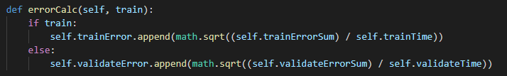
RMSE/Early Stopping Criteria
RMSE
Accumulates the average of both output errors squared
Early Stopping
Only come into effect after the third epoch
Check if error is less than previous for best values
Checks if error is less than 0.1
Considered to be close enough to real values
Accumulates consecutive times that current error was greater than past error
If this exceeds 5 end training

Slide 8
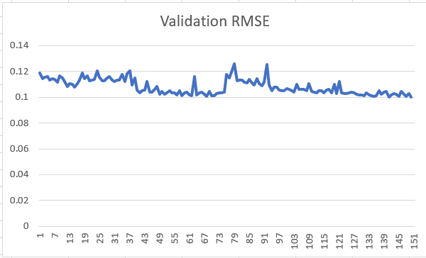
RMSE
Network was stopped at an error of 0.09923
RMSE
Epochs

